Slide 1
Smith Chart
by
S. Yuvaraj
Department of Electronics and Communication Engineering,
NIT Andhra Pradesh

Slide 2
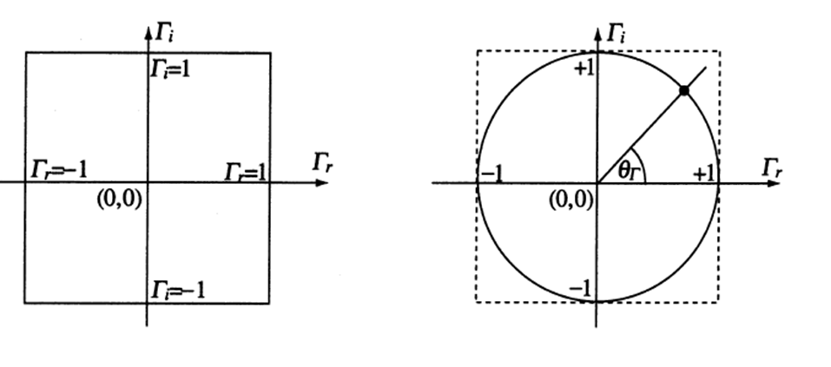
Complex Γ Plane

Slide 3
Constant Resistance Circles

Slide 4
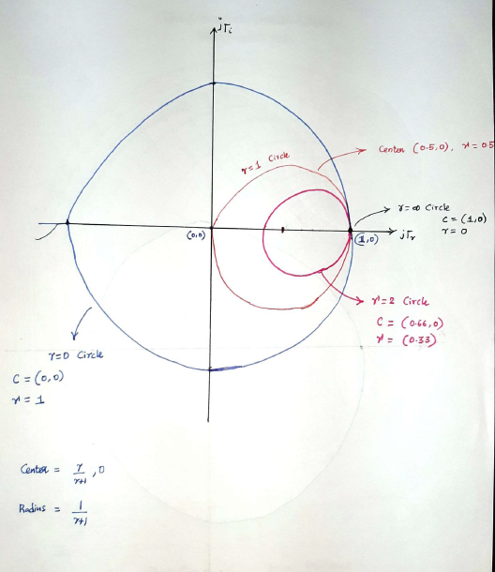

Slide 5
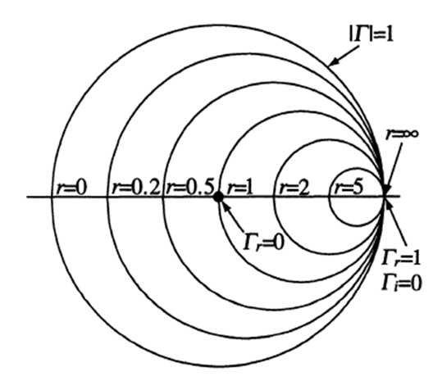
Constant Resistance Circles

Slide 6
Constant Reactance Circles

Slide 7
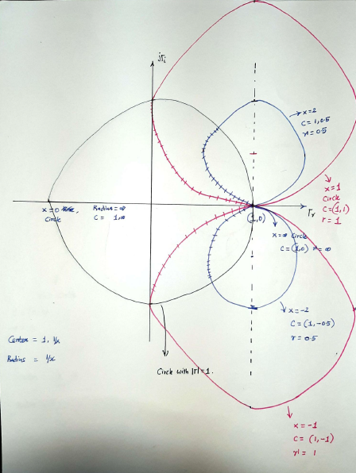

Slide 8
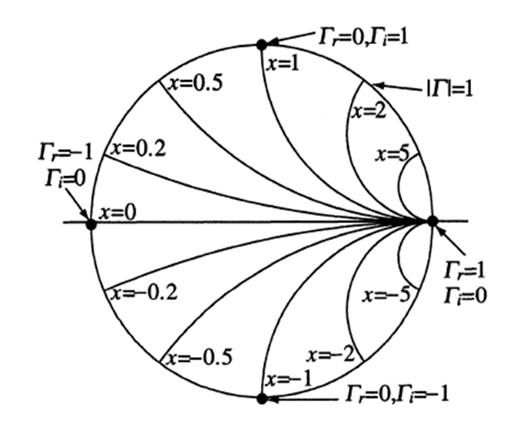
Constant Reactance Circles

Slide 9
Important Points in Smith Chart

Slide 10
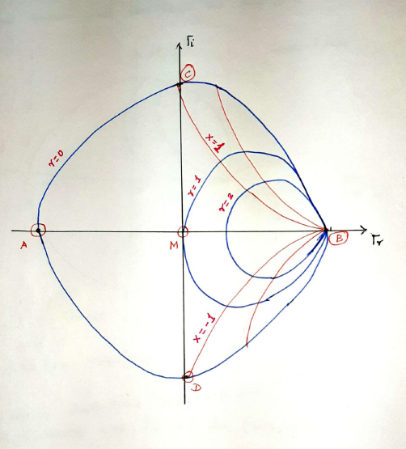

Slide 11
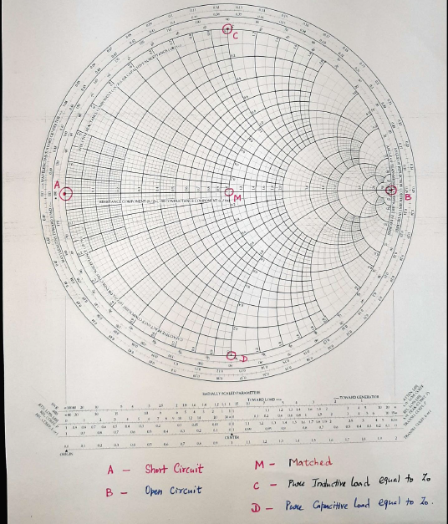

Slide 12
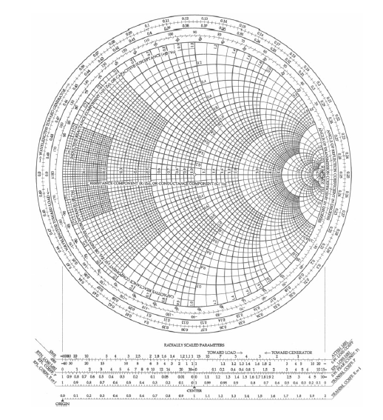
S

Slide 13
Plotting Normalized Impedance in Smith Chart

Slide 14
Load Impedance Z_{R} = 25 + j100 (Ω)
Characteristic Impedance Z_{o} = 50 (Ω)

Slide 15
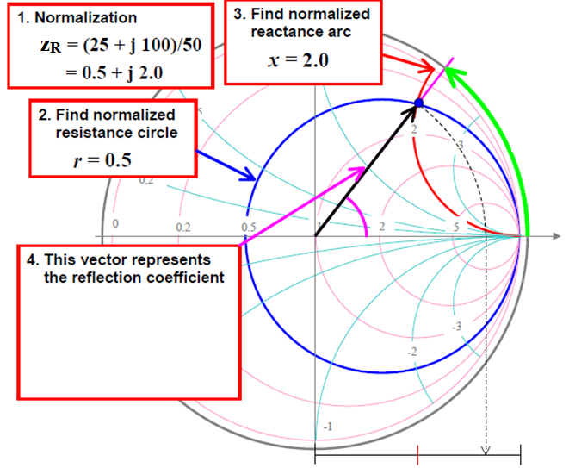

Slide 16
Finding the reflection coefficient (Magnitude and Phase)

Slide 17
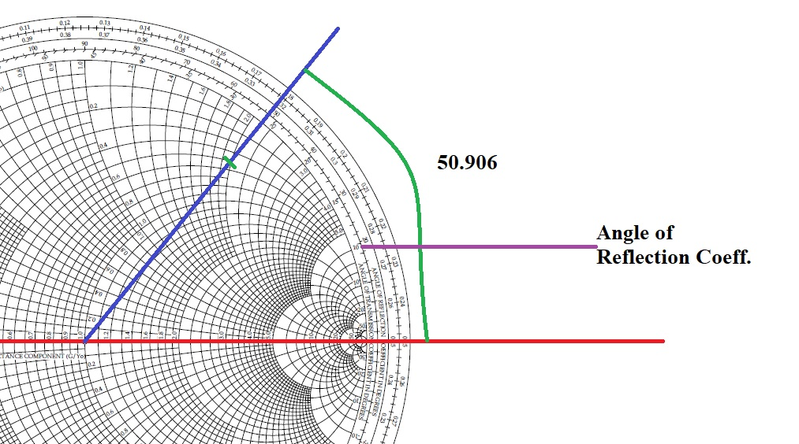

Slide 18
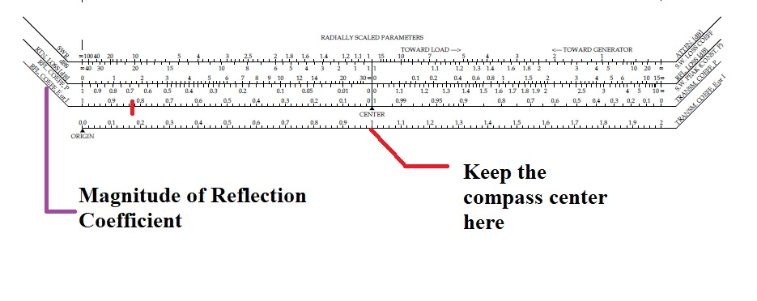

Slide 19
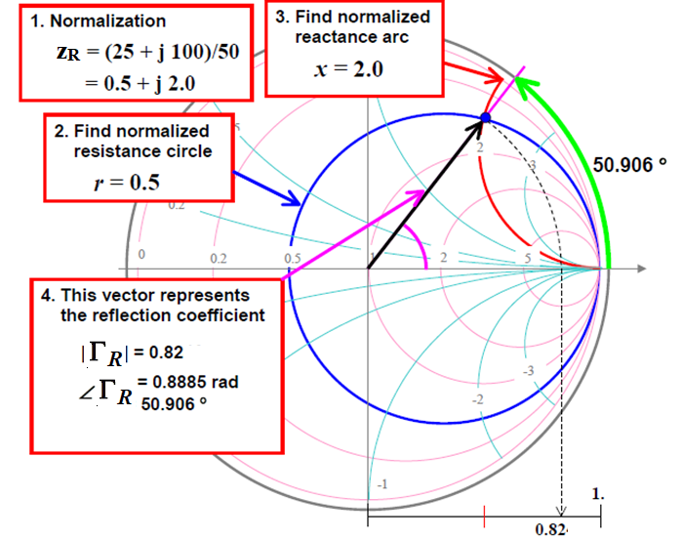

Slide 20
Impedance at the location 0.18 λ from load

Slide 21
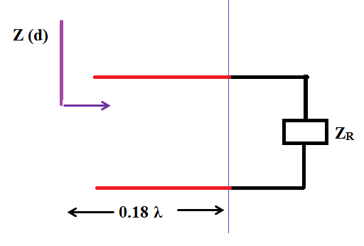

Slide 22
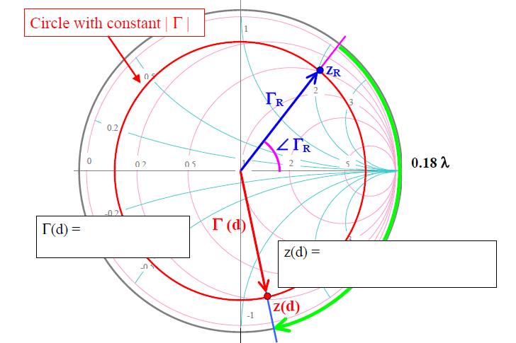

Slide 23
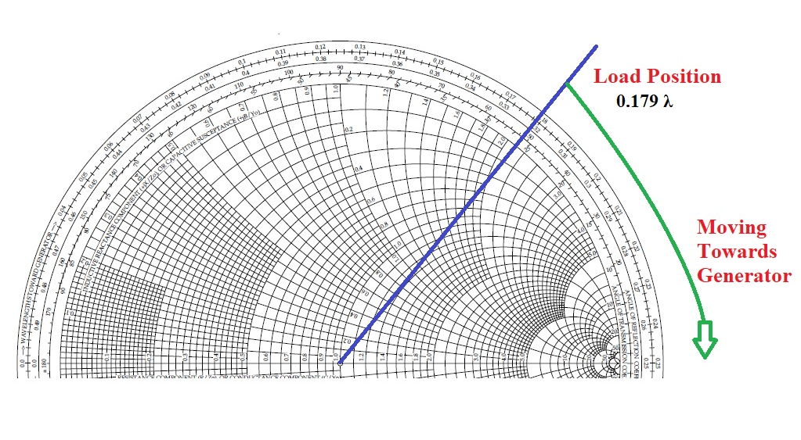

Slide 24
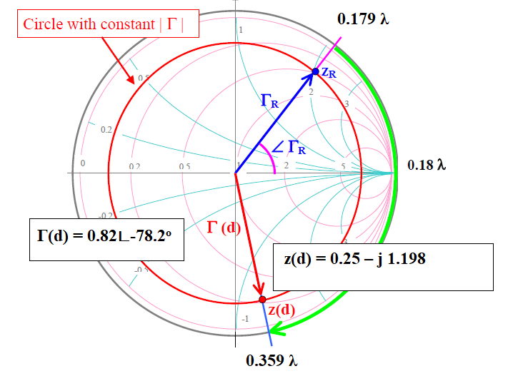

Slide 25
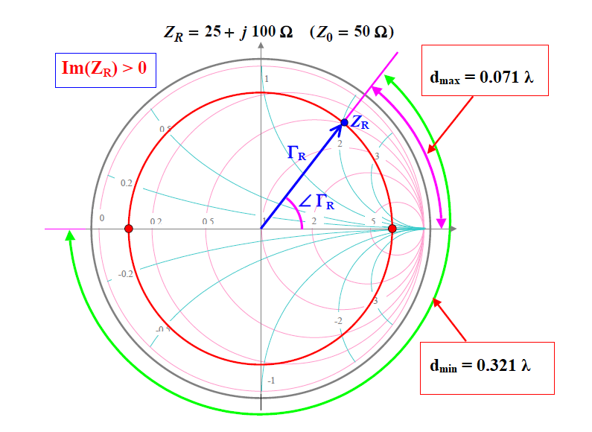

Slide 26
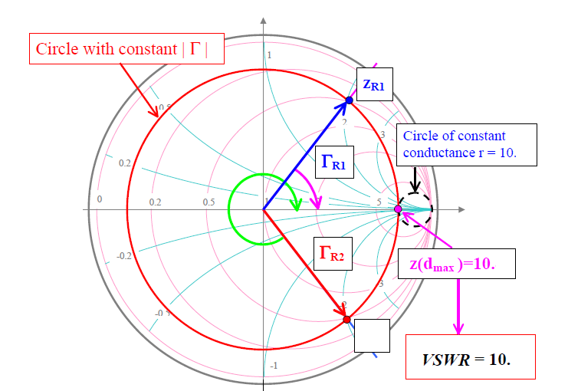

Slide 27
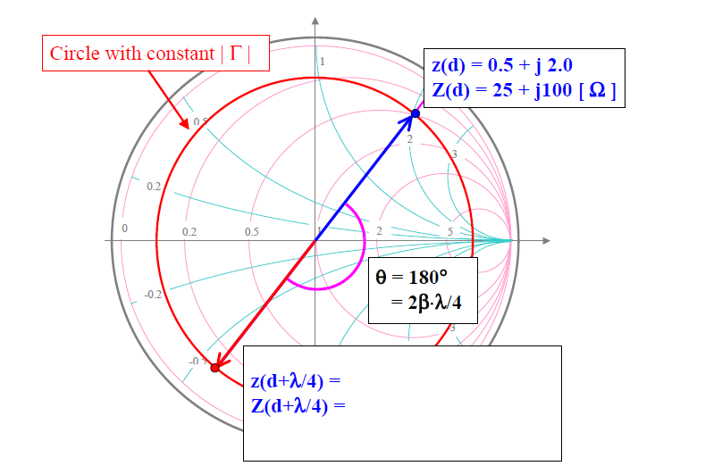

Slide 28
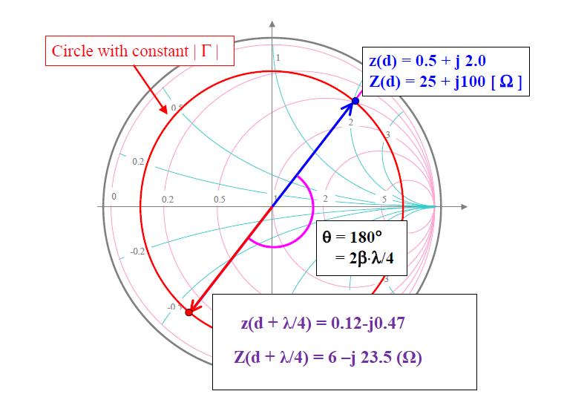

Slide 29
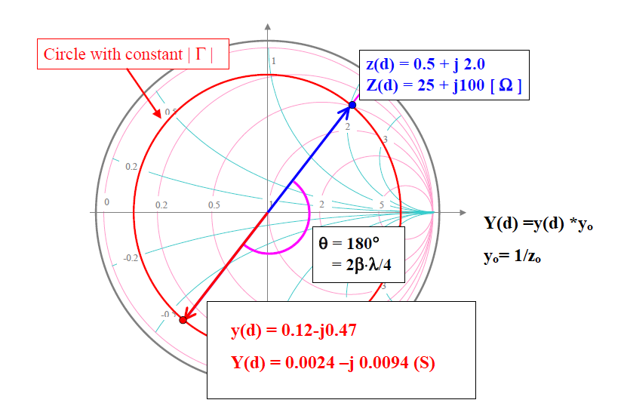

Slide 30


